Slide 1
Filled Area Primitive
A standard output primitive in general graphics is solid color or patterned polygon area. Other kinds of area primitives are sometimes available, but polygons are easier to process since they have linear boundaries.
The main idea behind the 2D or 3D object filling procedure is that it provides us more
realism on the object of interest.
There are two basic approaches to area filling in raster systems.
➢ One way to fill an area is to determine the overlap intervals for scan lines that crosses the area.
➢ Another method for area filling is to start from a given interior position and point outward from this until a specified boundary is met.

Slide 2
Area Fill Algorithm
• Basically, a boundary-fill algorithm starts from an interior point (x, y) and sets the neighboring points to the desired color.
• This procedure continues until all pixels are processed up to the designated boundary for the area.

Slide 3
There are two methods for processing neighboring pixels from a current point.
Four neighboring points.
• These are the pixel positions that are right, left, above, and below the current pixel.
• Areas filled by this method are called 4 - connected.
2. Eight neighboring points.
• This method is used to fill more complex figures.
• Here the set of neighboring points to be set includes the four diagonal pixels, in addition to the four points in the first method.
• Fill methods using this approach are called 8- connected.

Slide 4
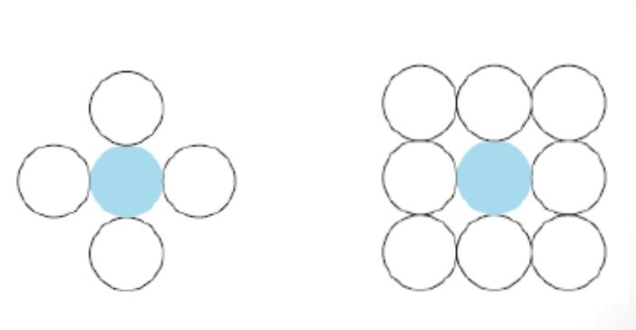

Slide 5
• Using either a 4-connected or 8-connected approach, we then step through pixel positions until all interior points have been repainted.
• The following procedure flood fills a 4-connected region recursively, starting from the input position.

Slide 6
Algorithm for Boundary fill 4- connected:
void Boundary_fill4(int x,int y,int b_color, int fill_color)
{
int value=getpixel (x,y);
if (value ! = b_color && value != fill_color)
{
putpixel (x,y,fill_color);
Boundary_fill4(x-1,y, b_color, fill_color);
Boundary_fill4(x+1,y, b_color, fill_color);
Boundary_fill4(x,y-1, b_color, fill_color);
Boundary_fill4(x,y+1, b_color, fill_color);
}
}

Slide 7
Algorithm for Boundary fill 8- connected:
void Boundary-fill8(int x,int y,int b_color, int fill_color)
{
int current =getpixel(x,y);
if (current != b_color && current != fill_color)
{
putpixel (x,y,fill_color);
Boundary_fill8(x-1,y,b_color,fill_color);
Boundary_fill8(x+1,y,b_color,fill_color);
Boundary_fill8(x,y-1,b_color,fill_color);
Boundary_fill8(x,y+1,b_color,fill_color);
Boundary_fill8(x-1,y-1,b_color,fill_color);
Boundary_fill8(x-1,y+1,b_color,fill_color);
Boundary_fill8(x+1,y-1,b_color,fill_color);
Boundary_fill8(x+1,y+1,b_color,fill_color);
}
}

Slide 8
Recursive boundary-fill algorithm not fill regions correctly if some interior pixels are already displayed in the fill color.
Encountering a pixel with the fill color can cause a recursive branch to terminate, leaving other interior pixel unfilled.
To avoid this we can first change the color of any interior pixels that are initially set to the fill color before applying the boundary fill procedure.

Slide 9
Flood-fill Algorithm:
Flood-fill Algorithm is applicable when we want to fill an area that is not defined within a single color boundary.
If fill area is bounded with different color, we can paint that area by replacing a specified interior color instead of searching of boundary color value.
This approach is called flood fill algorithm.
We start from a specified interior pixel (x,y) and reassign all pixel values that are currently set to a given interior color with desired fill_color.
Using either 4-connected or 8-connected region recursively starting from input position, The algorithm fills the area by desired color.

Slide 10
Algorithm:
void flood_fill4(int x,int y,int fill_color,int old_color)
{
int current;
current = getpixel (x,y);
if (current == old_color)
{
putpixel (x,y,fill_color);
flood_fill4(x-1,y, fill_color, old_color);
flood_fill4(x,y-1, fill_color, old_color);
flood_fill4(x,y+1, fill_color, old_color);
flood_fill4(x+1,y, fill_color, old_color);
}
}

Slide 11
